Slide 1
Lexis Red® Briefing
  App version 3.17 – released 24th Feb 2022

Slide 2
Important updates in Lexis Red 3.17
Overview
New welcome message for certain users
New publication cover design
Return borrowed titles on publications page
Publication information available in Digital Library
Annotations remain accessible even after loan title expires

Slide 3
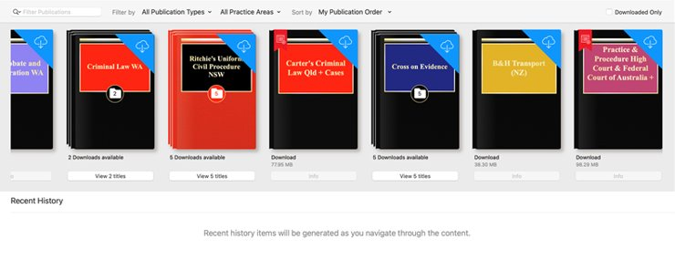
New publication cover design
Problem statement: The cover designs in Lexis Red appeared out of date and were not appealing to many users.
Solution: New cover designs have been created which update the experience and appeal to the familiarity of the hardcopy covers.
iPad image 3.17

Slide 4
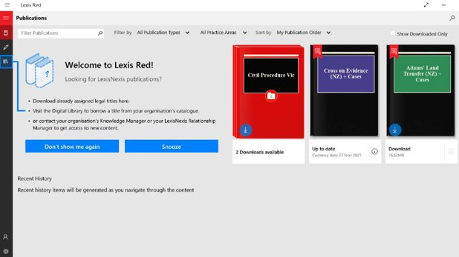
New welcome screen for certain users
Problem statement: First time Red users were confused about how to get started with Red publications.
Solution: Users who log in to the Lexis Red app for the first time or after a prolonged absence, or who have no downloaded publications, will be greeted with a welcome screen listing the different ways to get content on Red. This welcome screen will only be shown to users who are on accounts with the Digital Library enabled.
Windows image 3.17

Slide 5
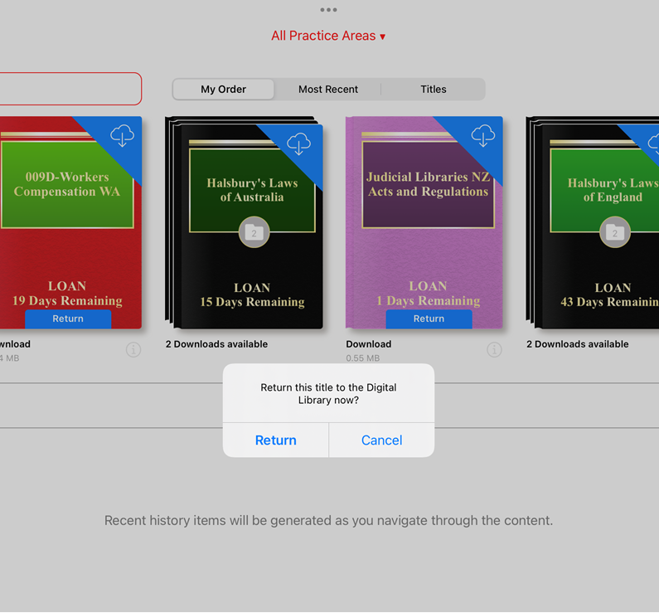
Return borrowed titles on publications page
Problem statement: Users want to be able to return borrowed titles in the Lexis Red app without having to open the Digital Library, saving them time and steps.
Solution: Users will now be able to return borrowed titles from the publications page in the Lexis Red app by clicking the “return” button on the publication cover.
Windows image 3.17
iPad image 3.17

Slide 6
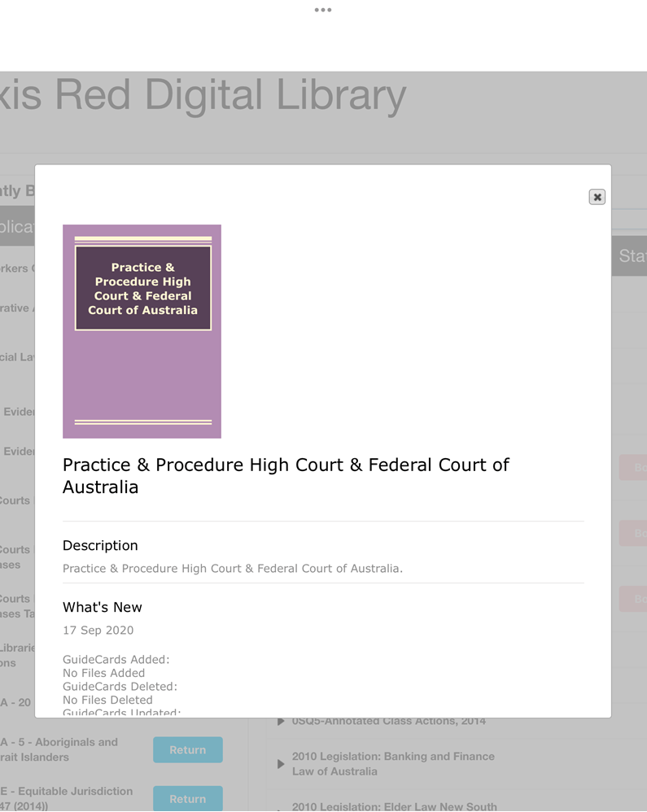
Publication information available in Digital Library
Problem statement: Users want to know more about a publication before deciding whether or not to borrow it from the Digital Library.
Solution: Users will now be able to view information about each publication in Digital Library by clicking on the iModal icon next to the title of the publication. This will display a pop up containing a description of the publication, the table of content, a list of recent updates and other relevant information.
Windows image 3.17
iPad image 3.17

Slide 7
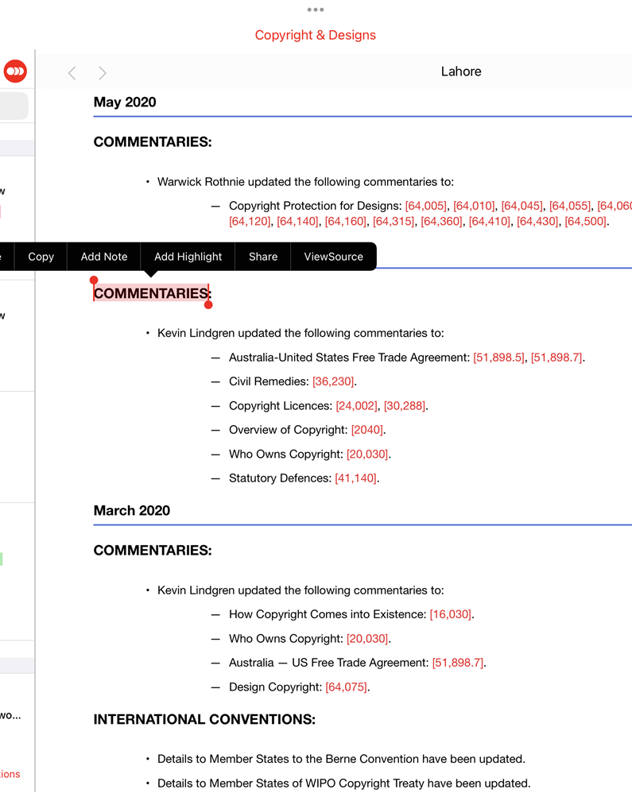
Annotations saved to the cloud and remain accessible even after a publication expires
Problem statement: Users want their annotations to persist between instances of borrowing a publication so that they don’t lose their valuable work.
Solution: A user’s annotations and highlights on a publication are saved to the cloud and will be accessible if the user re-loans the publication.
iPad image 3.17

Slide 8
Lexis Red
Support Information
Installation packages
Guides to assist you with downloading the Lexi Red app, by preferred device, are available here.
Support process
If you have any device issues, please contact the Customer Support team via customersupport@lexisnexis.com.nz or 0800 800 986 (8:00am to 5:00pm business days)
Useful links
  Lexis Red Microsite
  Release Notes
  Knowledge Network

Slide 9
Thank you.

